Slide 1
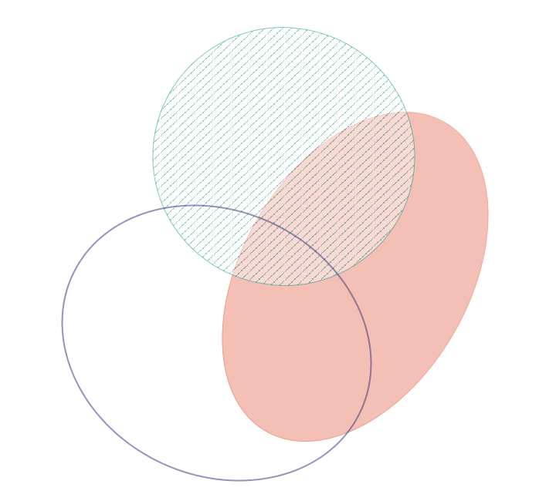
400 µatm vs. 400 µatm + Mech. Stress
400 µatm vs. 2800 µatm
56
28
7
8
45
38
70
2800 µatm vs. 2800 µatm + Mech. Stress

